Slide 1

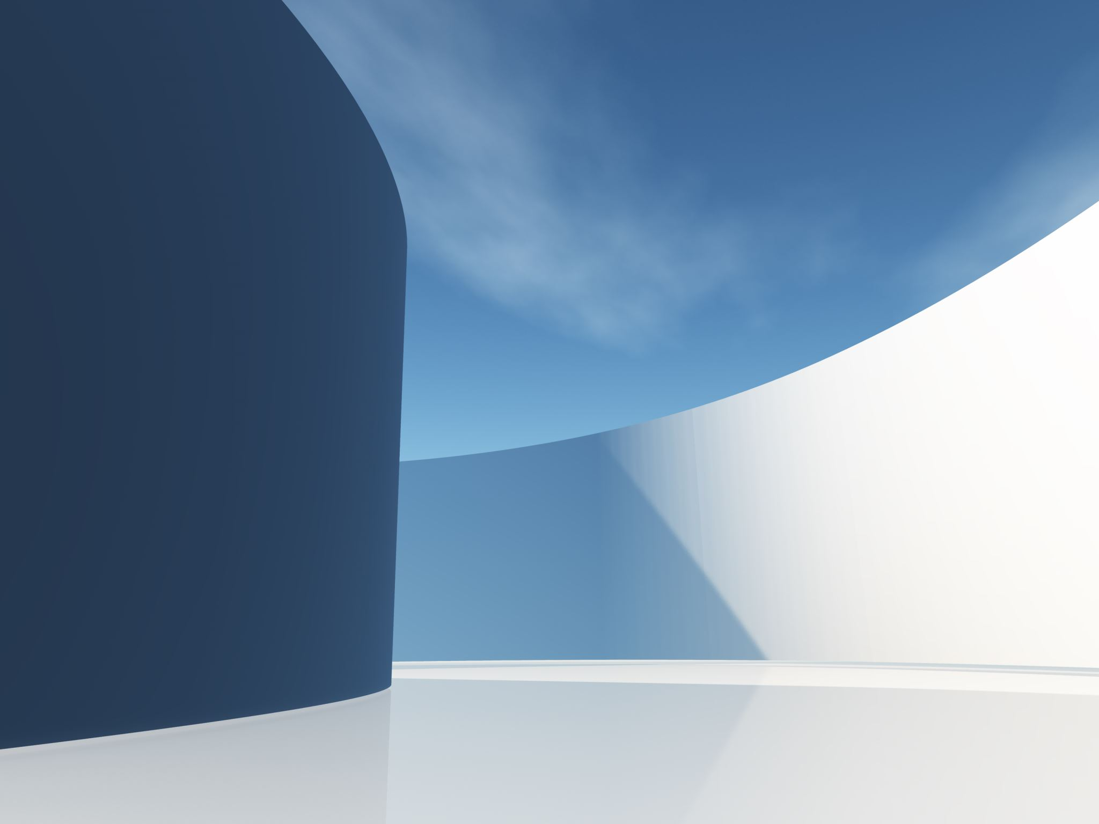

Open Platform for BIM Education
Daniel Danzer | 2177131
Max Kliegel | 2194475
Sadaf Saidzada | 2197447

Slide 2

Project Goal
Development of an open, web-based platform for BIM education
Provision of learning materials
Integration of interactive features for BIM model visualization
Support for students and professionals in understanding and applying BIM technologies

Slide 3
Reqired Components
BIM Formats & Interoperability
Use and showcase open BIM formats
Enable operations between different software
Learning Resources & Courses
Courses for different skill levels
Progress tracking in the dashboard (percentage of basics completed)
Tutorials & Sorting
Filter by difficulty & use case (software, task, etc.)
Rating & feedback system
Practice Files & Instructions
Sample files for practice with step-by-step instructions
Community Section
Upload, answer, and search for questions
Overview of current discussions
User Roles & Permissions
Simulations (e.g., EnergyPlus)

Slide 4

Project Implementation Plan
Choice of Technologies
Programming languages: Django, using SQL, Python or JavaScript
Database: SQL, maybe similar solutions
Possible Frameworks and tools: APIs for integration with common BIM software solutions (e.g., Autodesk)

Slide 5
UI Mockup And Database Design
Link
https://miro.com/app/board/uXjVIL5zPx4=/

Slide 6


New And Not Familiar Topics
Details of Building Information Modelling (BIM)
BIM file formats and standards (e.g. Revit, DWG, IFC)
APIs for accessing BIM data (e.g. Autodesk)
E-learning concepts and UX/UI principles for educational platforms

Slide 7

Thank You For Your Attention

